Slide 1

ROHM Sensor Eval Kit
ROHM Sensor Evaluation Kit Specification
ROHM Semiconductor USA, LLC

Slide 2
General Requirements
Overview
  ROHM wants to build on the pillar of power and sensor systems, yet we don’t have a good evaluation kit program that can be used to evaluate our Sensors.
Target Audience
  Engineers looking to evaluate/qualify sensors products
    High Level/Stand-alone Quick Test to verify operation
    Ease of connecting part to different systems
Sensors to Cover
  Hall IC
  Ambient Light Sensors
  UV Sensor
  MEMS Sensors
  Temperature Sensors
ROHM Semiconductor USA, LLC

Slide 3
Feature Set
PCB Board size needs to be as small as possible
Needs to show all sensors at low cost
  Accomplished using a modular Design consisting of a Base Board controller and Breakout “IC only” Board
  Common Breakout Board Patterns
Usage
  PC App
    Currently planning on only outputting directly to the UART console output. C# GUI can be made specifically for this; but we should consider only using a UART console since this is primarily for evaluation (as I can’t see anyone sitting down and using this GUI for very long). Also, the GUI hides some of the understanding of how everything is working by hiding the COM commands.
    I think all we really need is for the device to send out UART commands for the Sensor Output to a console at a fixed frequency
    We should use the UART to USB COM interface (cheaper FTDI part)
    Firmware dependent on how the Breakout Boards “control signals” are wired. Upon start up, the initialization will check and run the appropriate firmware for this
  Standalone
    Indication of sensor values can be shown using a string of 8 LEDs. These 8 LEDs will use a binary representation to display scaling from 0 to 255.
    Depending on the sensor, this scaling will not work.
      Hall Sensor: ON/OFF we can just turn on LED 1 for ON, LED7 for OFF
      Accel/Gyro: Depending on degree of tilt, we will turn on more or less LEDs
Power Supply
  Coin-cell Battery for Standalone Usage
  FTDI/USB VBUS For PC/Mobile Usage
ROHM Semiconductor USA, LLC

Slide 4
Design/Manufacturing Requirements
Design Stage
  PCB size for base board needs to be as small as possible
  Design Required in OrCad as done previously
Prototyping/Testing Stage
  Prototype testing is only required for the base platform and for one PN within each of the firmware groups (8 in total)
  For app note characterization testing, ROHM will need some time to write and test the MCU firmware. This firmware development will happen during the design stage and will extend into the prototyping stage. ROHM will verify firmware and then help and explain how to “flash” the MCU. At that time, more information for required testing per IC type will be provided.
Fabrication/Assembly Stage
  Ideally, we want to provide coverage for all ROHM Sensors and have a fewer number of Base Boards to support this product line with lower risk. Thus, we would like the following quantities (but if you are able to get a better deal, please let us know)
    50 to 100 pieces of each IC Breakout board
      18 PNs of Hall IC
      12 PNs of Ambient Light Sensors
      1 PN of UV Sensor
      2 PNs of MEMS Sensors
      18 PNs of Temperature Sensors
    200 Pieces of the Base Board Platform
EVK Testing Stage
  Once firmware has been finalized, we will provide instructions on testing each EVK Board.
ROHM Semiconductor USA, LLC

Slide 5
Base Board Requirements
Main Component Explanation
  ML610Q112 Lapis MCU for Low Power Operation
    25 Pins
      14 Pins Routed to Header (+2 for PWR/GND)
        x2 I2C, x2 ADC, x4GPIO
        x6 GPIO for Sensor Type Control
      2 Pins For UART/FTDI/USB
      1 Pin for Vmon
      8 Pins Routed to LEDs for Binary Output
  FTDI: FT230XS-R for UART to USB communication
    This should be exactly the same as the LaPi Board
  ROHM, 3V LDO for Supply to MCU and Sensors
    Need to check if all sensors can use this
  Sensor Interface
    Standard Pitch (2.54mm) 5x2 Header
    x2 I2C, x2 ADC, x4 GPIO
    x6 GPIO for “plug and play” Sensor Selection
Firmware Types to Be Created
  Hall IC (x2 for Single and Dual Output)
  ALS (x2 for Analog and Digital Output)
  UV Sensor (x1 for the single chip)
  MEMs Sensor (Depends on what we want to show)
  Temperature Sensor (x3 for normal and thermostat active high/low output)
ROHM Semiconductor USA, LLC

Slide 6
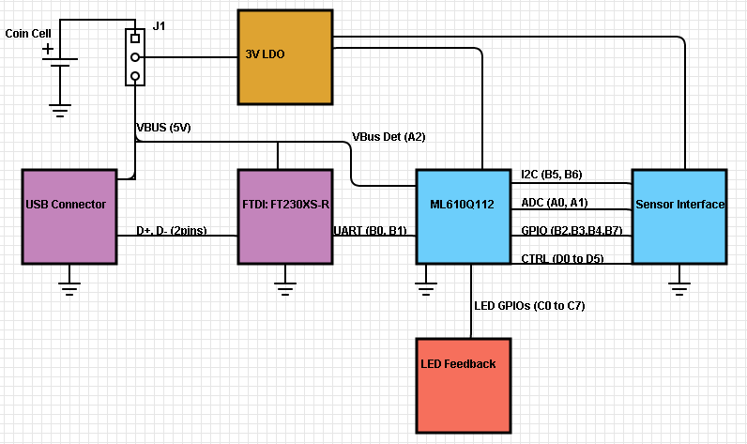
High Level Schematic – Base Board
Use ROHM PicoLEDs
We also want to have VIAs for Port C (C.0 to C.7) and Port D (D.0 to D.5) on the side of the board
ROHM Semiconductor USA, LLC

Slide 7
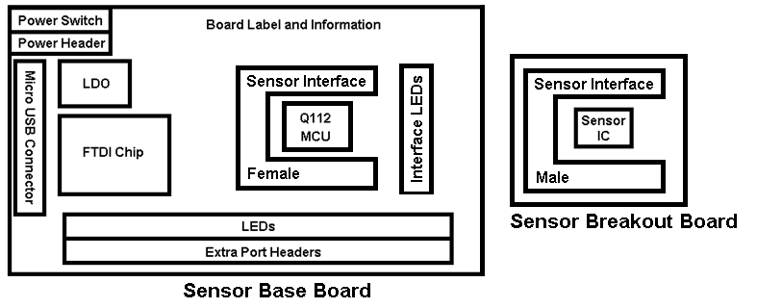
High Level Layout – Base and Breakout Board
The above layout is a general guideline for the layout (not to scale)
  Target Size for Base Board = 600mm² (estimated based on components)
  Target Size for Breakout Board = 235mm² (estimated based on components)
Please note that the layout for both boards should be as small as we can make it (2 Layers)
  Ideally, the base board would be the size of a flash drive, and the breakout board is smaller (accordingly)
ROHM Semiconductor USA, LLC

Slide 8
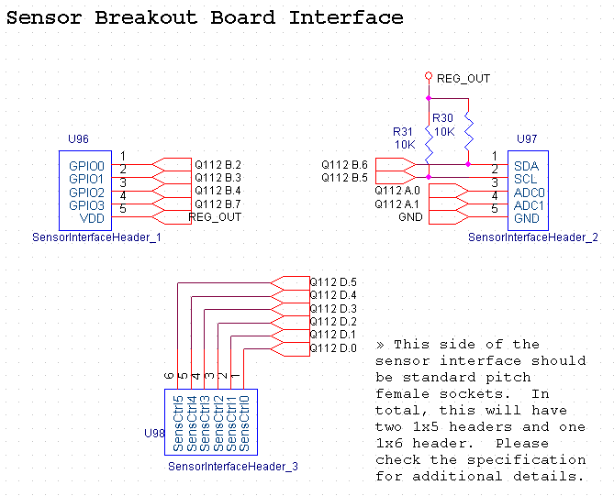
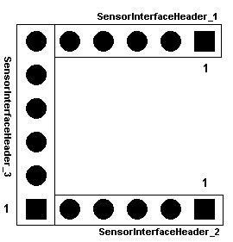
Schematic Details – Sensor Interface
Base board needs female headers on “SensorIntefaceHeader_1” and “…Header_3”. Needs male Headers on “…Header_2.
Breakout boards need male headers on “SensorIntefaceHeader_1” and “…Header_3”. Needs female Headers on “…Header_2.
*Please use std 2.54mm pitch headers
When building the breakout boards, we will want to have only the data transfer portion (I2C, ADC, GPIO digital input) and Power (Vin/GND) connected through the header.
Any “mode settings” should be jumper-able on the breakout board itself. Also, any external components should also be placed on the breakout board itself. Please see slides below for additional information on each of the sensor types
ROHM Semiconductor USA, LLC

Slide 9
Hall IC Breakout Board Requirements
Part Number | Design Type | Pins Req. | Firmware Type | Hardware Type | Other
BD7411G | Not Supported/Does Not Work at 3V |  |  |  | N/A
BU52001GUL | Omnipolar Only Design | Vin/GND OUT - GPIO1 | Firmware 1 H @ No Mag Field L @ Mag Present Sensor Control = 0 | Type 1, VCSP50L1, 4pin
BU52011HFV |  |  |  | Type 2, HVSOF5, 5pin
BU52015GUL |  |  |  | Type 3, VCSP50L1, 4pin (diff pinout)
BU52021HFV |  |  |  | Type 2, HVSOF5, 5pin
BU52025G |  |  |  | Type 2.1, SSOP5, 5pin
BU52053NVX |  |  |  | Type 4, SSON004X1216, 4pin
BU52054GWZ |  |  |  | Type 5, UCSP35L1, 4pin
BU52055GWZ |  |  |  | Type 5, UCSP35L1, 4pin
BU52056NVX |  |  |  | Type 4, SSON004X1216, 4pin
BU52061NVX |  |  |  | Type 4, SSON004X1216, 4pin
BU52002GUL | Unipolar Detection ICs |  |  | Type 1, VCSP50L1, 4pin
BU52003GUL |  |  |  | Type 1, VCSP50L1, 4pin
BU52012HFV |  |  |  | Type 2, HVSOF5, 5pin
BU52012NVX |  |  |  | Type 4, SSON004X1216, 4pin
BU52013HFV |  |  |  | Type 2, HVSOF5, 5pin
BU52040HFV | Bipolar Latch Hall IC |  |  | Type 2, HVSOF5, 5pin
BU52004GUL | Omnipolar w/ Polarity Discrimination | Vin/GND OUT1 - GPIO1 OUT2 - GPIO2 | Firmware 2 OUT1 – South Pole OUT2 – North Pole Sensor Control = 1 | Type 6, VCSP50L1, 4pin (diff pinout)
BU52014HFV |  |  |  | Type 7, HVSOF5, 5pin (diff pinout)
ROHM Semiconductor USA, LLC

Slide 10
ALS Breakout Board Requirements
Part Number | Design Type | Pins Req. | Firmware Type | Hardware Type | Other
BH1600FVC | Analog ALS | Vin/GND ADC1 | Firmware 3 Sensor Control = 5 | Type 1, WSOF6, 6pin | GC Pins need to be tied to GPIO
BH1603FVC |  |  |  | Type 1, WSOF6, 6pin
BH1620FVC |  |  |  | Type 2, WSOF5, 5pin
BH1621FVC |  |  |  | Type 2, WSOF5, 5pin
BH1680FVC |  |  |  | Type 2, WSOF5, 5pin
BH1710FVC | Digital ALS | Vin/GND SDA/SCL | Firmware 4 (0x23 Dev Addr) Sensor Control = 6 | Type 3, WSOF6, 6pin (Diff Pinout) | DVI pin tied to VCC (may need additional Cap)
BH1715FVC |  |  |  | Type 3, WSOF6, 6pin (Diff Pinout)
BH1750FVI |  |  |  | Type 6, WSOF6I, 6pin (same pinout as WSOF6)
BH1751FVI |  |  |  | Type 6, WSOF6I, 6pin (same pinout as WSOF6)
BH1721FVC |  |  | Firmware 6 (0x23 Dev Addr) Diff Register Set Sensor Control = 8 | Type 4, WSOF5, 5pin (Diff Pinout)
BH1730FVC |  |  | Firmware 5 (0x29 Dev Addr) Sensor Control = 7 | Type 5, WSOF6, 6pin (Diff Pinout)
BH1780GLI |  |  | Firmware 7 (0x29 Dev Addr) Diff Register Set Sensor Control = 9 | Type 7, WLGA04IW02, 4pin
ROHM Semiconductor USA, LLC

Slide 11
UV Sensor Breakout Board Requirements
Part Number | Design Type | Pins Req. | Firmware Type | Hardware Type | Other
ML8511 | UV Sensor | Vin/GND ADC1 | Firmware 8 Sensor Control = 10 | Type 1, C-TQFN12-4.0x3.7-1.00 | Enable pin should be tied to VCC
ROHM Semiconductor USA, LLC

Slide 12
MEMS Breakout Board Requirements
Part Number | Design Type | Pins Req. | Firmware Type | Hardware Type | Other
KX022 | I2C - Accel Only | Vin/GND SDA/SCL INT1/INT2 | Firmware 9 - Accel Only Software Sensor Control = 15 | Type 1, LGA_2x2x0.9, 12pin | IO VDD should be tied to VDD ADDR pin should be jumper able
KMX02 | I2C - Accel + Mag | Vin/GND SDA/SCL INT1/INT2 | Firmware 10 - Accel and Mag Software Sensor Control = 16 | Type 2, LGA_2x2x0.9, 16pin | IO VDD should be tied to VDD ADDR pin should be jumper able
ROHM Semiconductor USA, LLC

Slide 13
Temp Sensor Breakout Board Requirements
Part Number | Design Type | Pins Req. | Firmware Type | Hardware Type | Other
BD1020HFV | Analog Output Only | Vin/GND ADC1 | Firmware 11 Sensor Control = 20 | Type 1, HVSOF5, 5pin
BDJ0601HFV | Analog w/ Themostat (Active High) | Vin/GND ADC1 GPIO1 | Firmware 12 Sensor Control = 21 | Type 3, HVSOF5, 5pin | Control Pin should be jumpered on IC Board Type 3 Overlaps… Need to put resistor settings and control BOM for these firmware types
BDJ0701HFV |  |  |  | Type 3, HVSOF5, 5pin
BDJ0751HFV |  |  |  | Type 3, HVSOF5, 5pin
BDJ0801HFV |  |  |  | Type 3, HVSOF5, 5pin
BDJ0851HFV |  |  |  | Type 3, HVSOF5, 5pin
BDJ0901HFV |  |  |  | Type 3, HVSOF5, 5pin
BDE0600G | Analog w/ Themostat (Active Low) | Vin/GND ADC1 GPIO1 | Firmware 13 Sensor Control = 22 | Type 2, SSOP5, 5pin | Control Pin should be jumpered on IC Board Type 3 Overlaps… Need to put resistor settings and control BOM for these firmware types
BDE0700G |  |  |  | Type 2, SSOP5, 5pin
BDE0800G |  |  |  | Type 2, SSOP5, 5pin
BDE0900G |  |  |  | Type 2, SSOP5, 5pin
BDE1000G |  |  |  | Type 2, SSOP5, 5pin
BDE1100G |  |  |  | Type 2, SSOP5, 5pin
BDJ0550HFV |  |  | Firmware 14 (Diff ADC EQN) Sensor Control = 23 | Type 3, HVSOF5, 5pin
BDJ0600HFV |  |  |  | Type 3, HVSOF5, 5pin
BDJ0650HFV |  |  |  | Type 3, HVSOF5, 5pin
BDJ0700HFV |  |  |  | Type 3, HVSOF5, 5pin
BDJ0800HFV |  |  |  | Type 3, HVSOF5, 5pin
ROHM Semiconductor USA, LLC

Slide 14
Disclaimer
Some products in this document may have been replaced or may be under development. For the most current product information, contact a ROHM sales representative in your area: http://www.rohmsemiconductor.com/contact_us/contact_us.htm.
ROHM assumes no responsibility for the use of any circuits described herein, conveys no license under any patent or other right, and makes no representations that the circuits are free from patent infringement. Specifications subject to change without notice for the purpose of improvement.
The products listed in this document are designed to be used with ordinary electronic equipment or devices (such as audio visual equipment, office-automation equipment, communications devices, electrical appliances and electronic toys). Should you intend to use these products with equipment or devices which require an extremely high level of reliability and the malfunction of which would directly endanger human life (such as medical instruments, transportation equipment, aerospace machinery, nuclear-reactor controllers, fuel controllers and other safety devices), please be sure to consult with a ROHM sales representative in advance.
©2010 ROHM Semiconductor USA, LLC. Although every effort has been made to ensure accuracy, ROHM accepts no responsibility for errors or omissions. Specifications and product availability may be revised without notice. No part of this document represents an offer or contract. Industry part numbers, where specified, are given as an approximate comparative guide to circuit function only. Consult ROHM prior to use of components in safety, health or life-critical systems. All trademarks acknowledged.
ROHM Semiconductor USA, LLC

